Slide 1

Application: F1nance Type: Application Architecture View: Logical View Style: Layered Architecture Pattern
Users
Delivery Channels
Core Business Processes
Data And Information
Technology Enablers
Authentication
& Authorization
User Details
Payment Gateways
Bank Account Management
Bank Data
Finance API
Tax Data
Income Tracking Logic
International Student
Web Browser
AI Knowledge
Cloud Services (AWS )
AI Advising
Compliance Data
Email Service
Legal Affirmation
Financial Literacy Documents
Github & Delivery Pipeline
Admin
Customer Support
Economy Updates

Slide 2
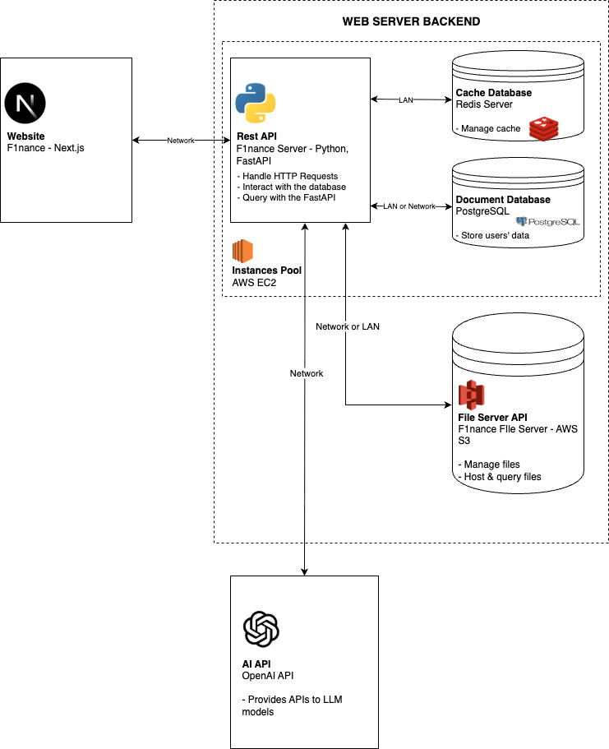
Application: F1nance Type: Application Architecture View: Process View Style: Client-Server Pattern

